Slide 1
Newton Forward Interpolation
http://numericalmethods.eng.usf.edu

Slide 2
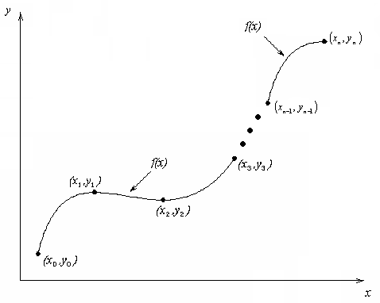
What is Interpolation ?
Given (x₀,y₀), (x₁,y₁), …… (x_{n},y_{n}), find the value of ‘y’ at a value of ‘x’ that is not given.
http://numericalmethods.eng.usf.edu

Slide 3

Interpolants
Polynomials are the most common choice of interpolants because they are easy to:
  Evaluate
  Differentiate, and
  Integrate.
http://numericalmethods.eng.usf.edu

Slide 4
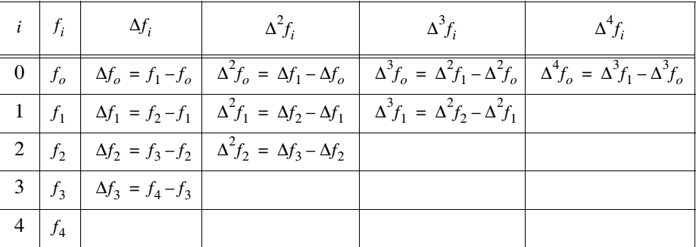

Slide 5
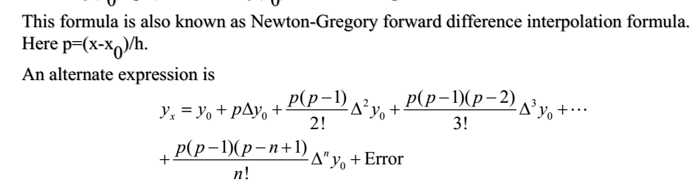
http://numericalmethods.eng.usf.edu

Slide 6
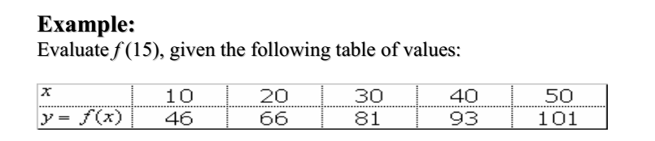
http://numericalmethods.eng.usf.edu

Slide 7
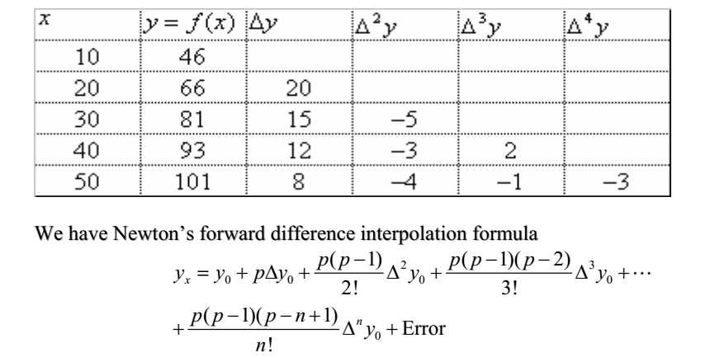
http://numericalmethods.eng.usf.edu

Slide 8
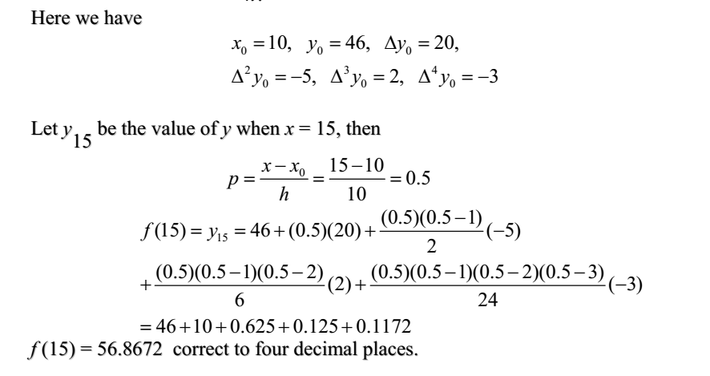
http://numericalmethods.eng.usf.edu

Slide 9
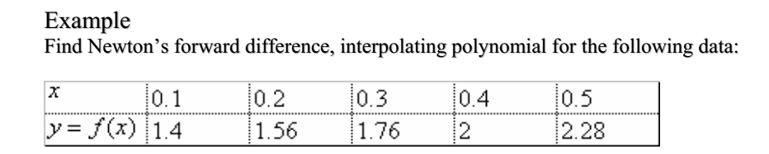
http://numericalmethods.eng.usf.edu

Slide 10
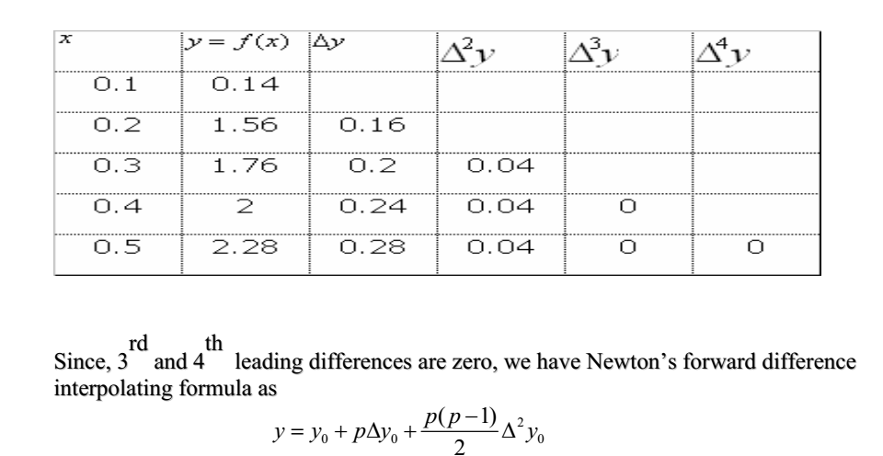
http://numericalmethods.eng.usf.edu

Slide 11
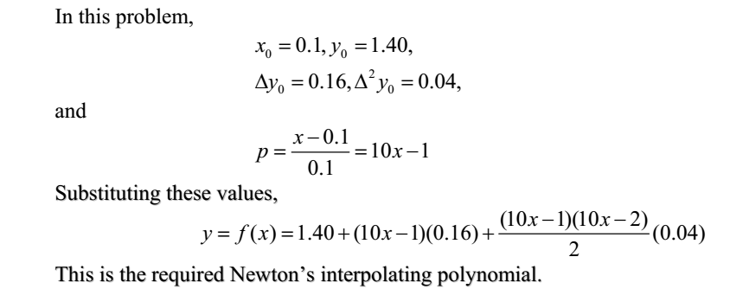
http://numericalmethods.eng.usf.edu

Slide 12
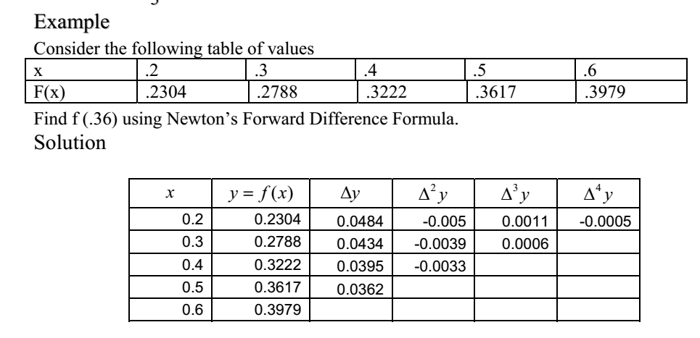
http://numericalmethods.eng.usf.edu

Slide 13
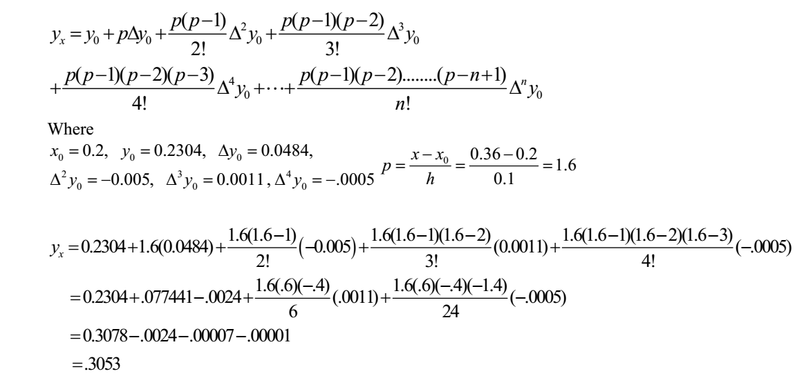
http://numericalmethods.eng.usf.edu

Slide 14
Newton’s Divided Difference Polynomial Method of Interpolation

Slide 15



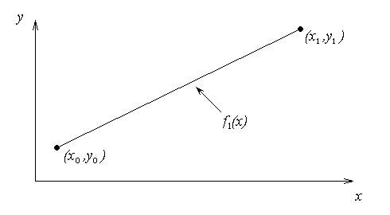

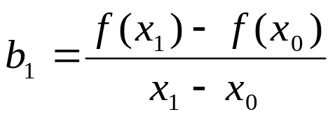
Newton’s Divided Difference Method
Linear interpolation: Given pass a linear interpolant through the data
where
http://numericalmethods.eng.usf.edu

Slide 16
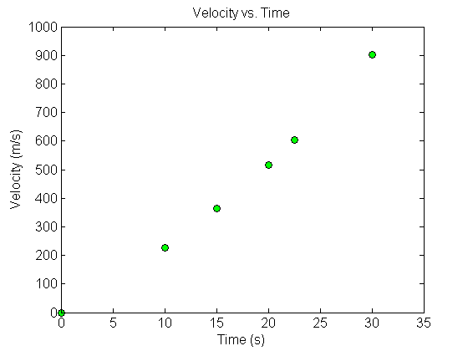



Example
The upward velocity of a rocket is given as a function of time in Table 1. Find the velocity at t=16 seconds using the Newton Divided Difference method for linear interpolation.
Table. Velocity as a
function of time
0 | 0
10 | 227.04
15 | 362.78
20 | 517.35
22.5 | 602.97
30 | 901.67
Figure. Velocity vs. time data
for the rocket example
http://numericalmethods.eng.usf.edu

Slide 17
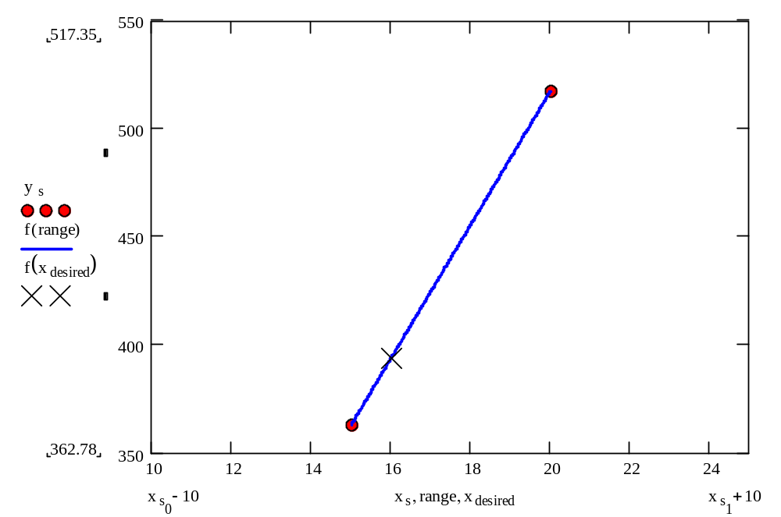
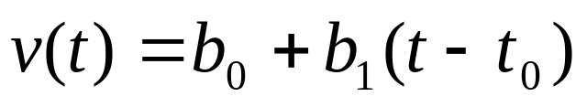
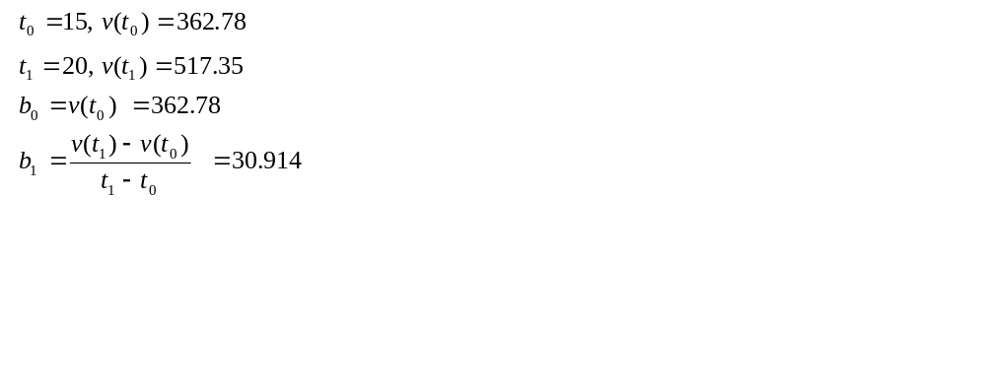
Linear Interpolation
http://numericalmethods.eng.usf.edu

Slide 18
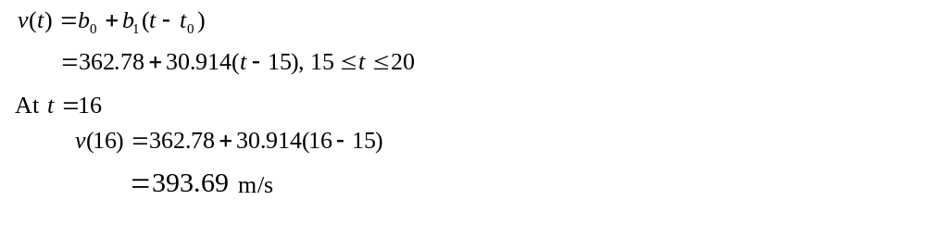
Linear Interpolation (contd)
http://numericalmethods.eng.usf.edu

Slide 19

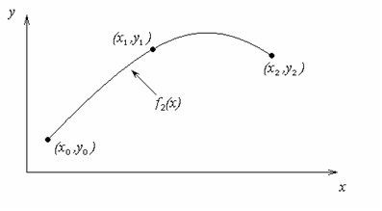
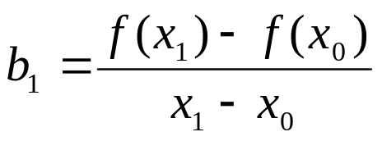
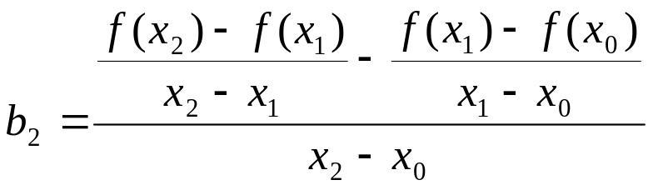
Quadratic Interpolation
http://numericalmethods.eng.usf.edu

Slide 20
Example
The upward velocity of a rocket is given as a function of time in Table 1. Find the velocity at t=16 seconds using the Newton Divided Difference method for quadratic interpolation.
Table. Velocity as a
function of time
0 | 0
10 | 227.04
15 | 362.78
20 | 517.35
22.5 | 602.97
30 | 901.67
Figure. Velocity vs. time data
for the rocket example
http://numericalmethods.eng.usf.edu

Slide 21
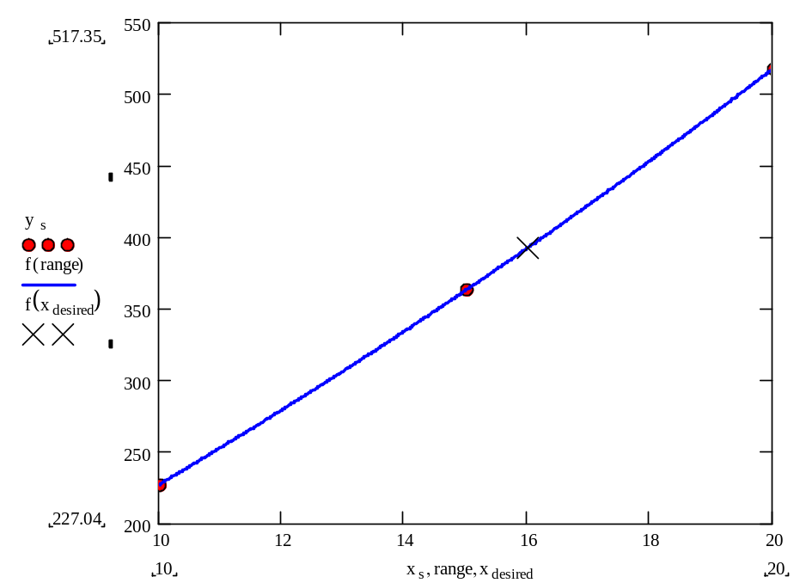
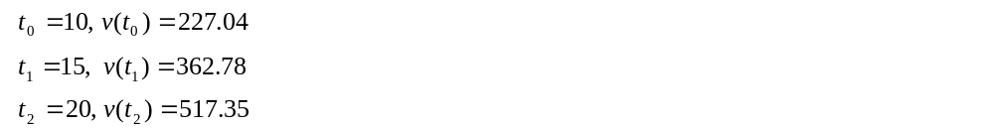
Quadratic Interpolation (contd)
http://numericalmethods.eng.usf.edu

Slide 22
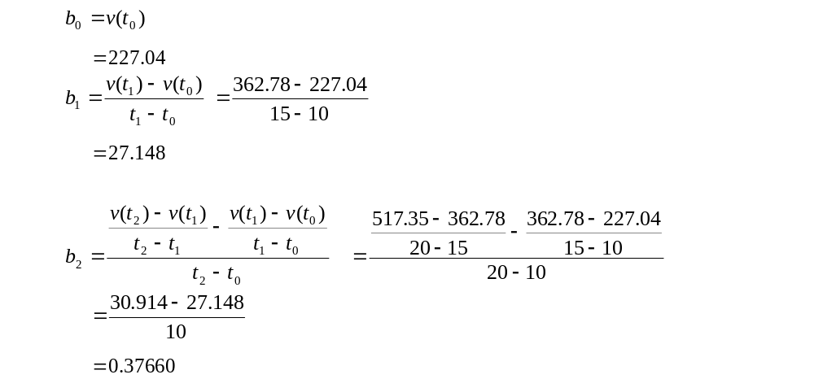
Quadratic Interpolation (contd)
http://numericalmethods.eng.usf.edu

Slide 23
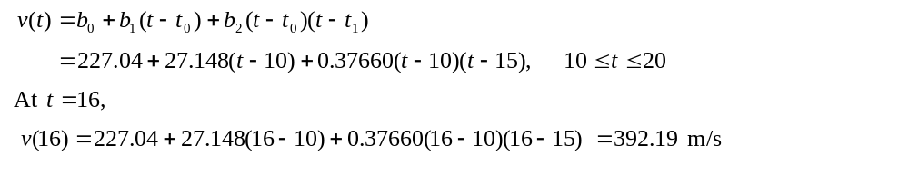
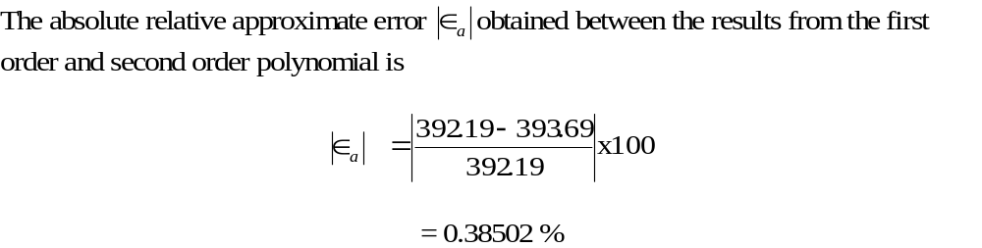
Quadratic Interpolation (contd)
http://numericalmethods.eng.usf.edu

Slide 24
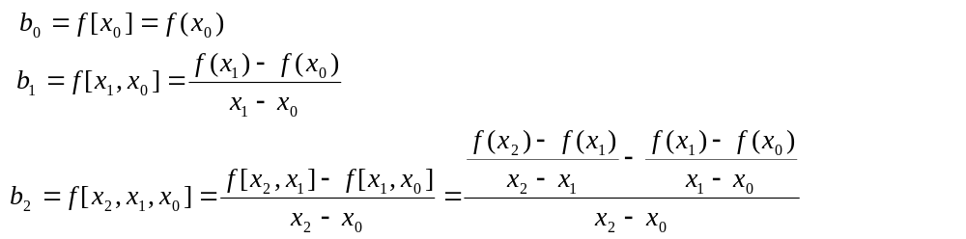
General Form
where
Rewriting
http://numericalmethods.eng.usf.edu

Slide 25
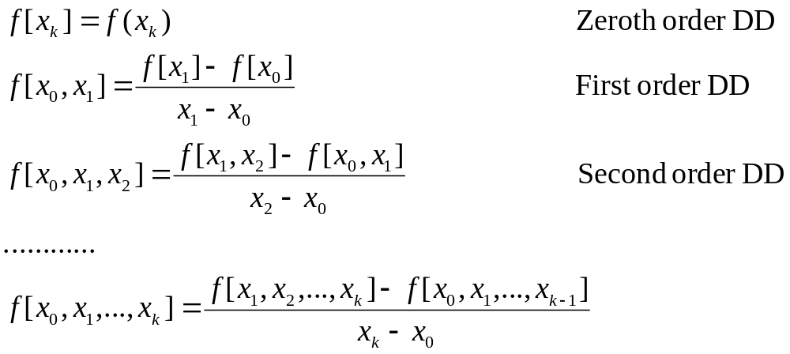
Divided Differences

Slide 26
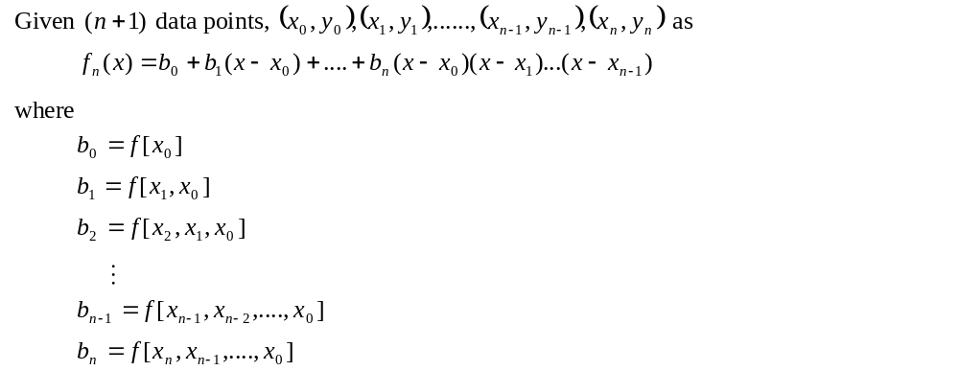
General Form
http://numericalmethods.eng.usf.edu

Slide 27
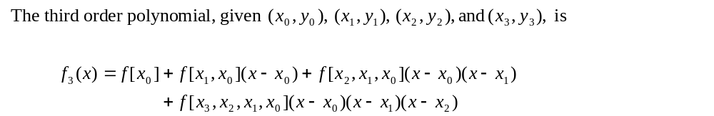
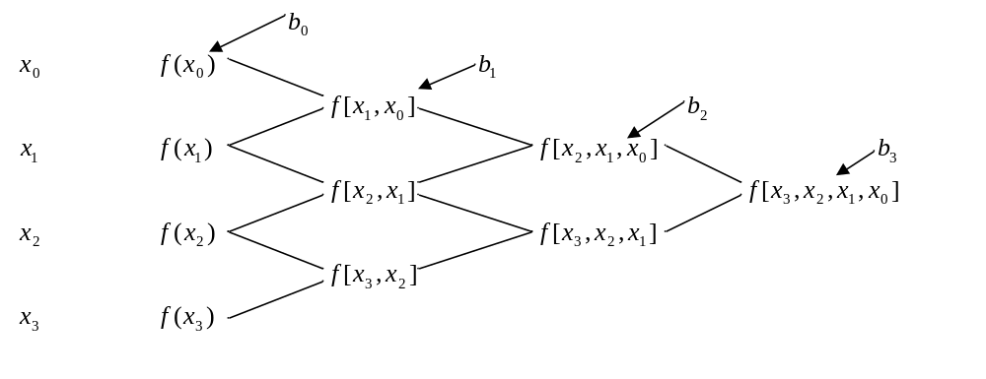
General form
http://numericalmethods.eng.usf.edu

Slide 28

Divided Difference Table
x | F[ ] | F[ , ] | F[ , , ]
0 | -5 | 2 | -4
1 | -3 | 6
-1 | -15
 | f(x_{i})
0 | -5
1 | -3
-1 | -15
Entries of the divided difference table are obtained from the data table using simple operations.

Slide 29
Divided Difference Table
x | F[ ] | F[ , ] | F[ , , ]
0 | -5 | 2 | -4
1 | -3 | 6
-1 | -15
 | f(x_{i})
0 | -5
1 | -3
-1 | -15
The first two column of the
table are the data columns.
Third column: First order differences.
Fourth column: Second order differences.

Slide 30

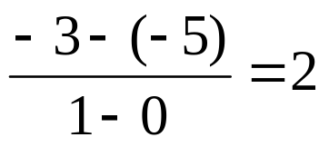
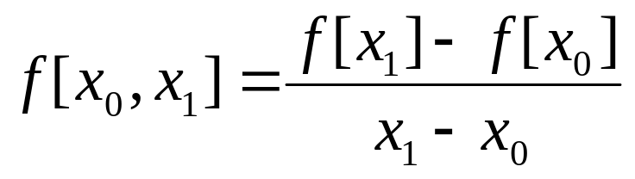
Divided Difference Table
0 | -5
1 | -3
-1 | -15
x | F[ ] | F[ , ] | F[ , , ]
0 | -5 | 2 | -4
1 | -3 | 6
-1 | -15

Slide 31
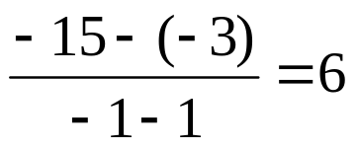
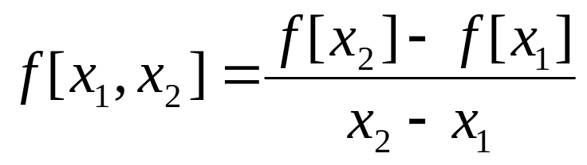
Divided Difference Table
0 | -5
1 | -3
-1 | -15
x | F[ ] | F[ , ] | F[ , , ]
0 | -5 | 2 | -4
1 | -3 | 6
-1 | -15

Slide 32
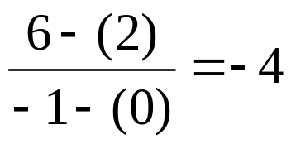
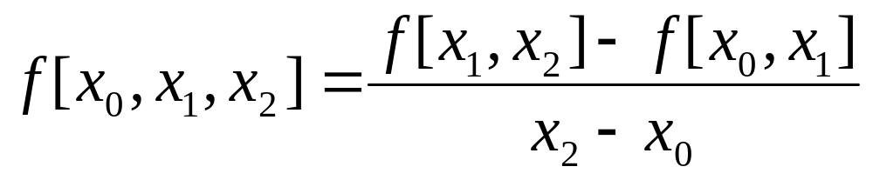
Divided Difference Table
0 | -5
1 | -3
-1 | -15
x | F[ ] | F[ , ] | F[ , , ]
0 | -5 | 2 | -4
1 | -3 | 6
-1 | -15

Slide 33
Divided Difference Table
0 | -5
1 | -3
-1 | -15
x | F[ ] | F[ , ] | F[ , , ]
0 | -5 | 2 | -4
1 | -3 | 6
-1 | -15
f₂(x)= F[x₀]+F[x₀,x₁] (x-x₀)+F[x₀,x₁,x₂] (x-x₀)(x-x₁)

Slide 34
Example
The upward velocity of a rocket is given as a function of time in Table 1. Find the velocity at t=16 seconds using the Newton Divided Difference method for cubic interpolation.
Table. Velocity as a
function of time
0 | 0
10 | 227.04
15 | 362.78
20 | 517.35
22.5 | 602.97
30 | 901.67
Figure. Velocity vs. time data
for the rocket example
http://numericalmethods.eng.usf.edu

Slide 35

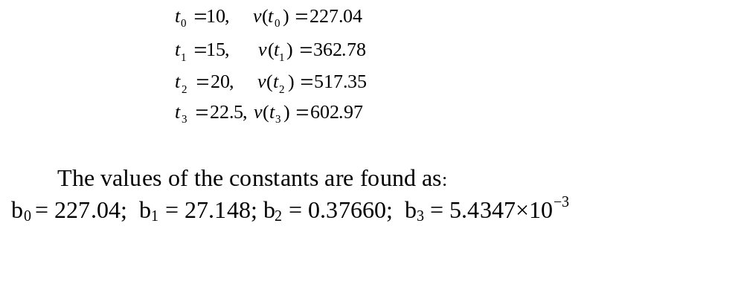
Example
The velocity profile is chosen as
we need to choose four data points that are closest to
http://numericalmethods.eng.usf.edu

Slide 36
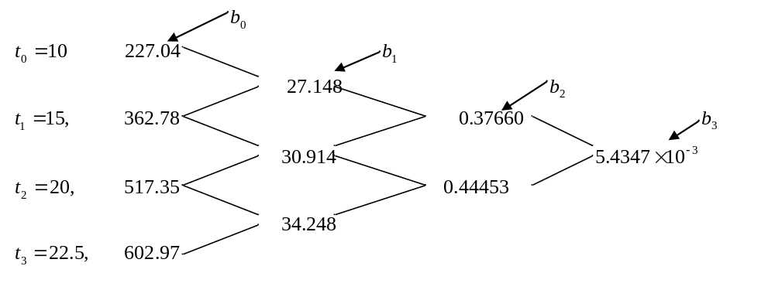
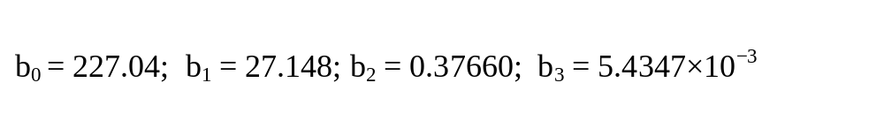
Example
http://numericalmethods.eng.usf.edu

Slide 37
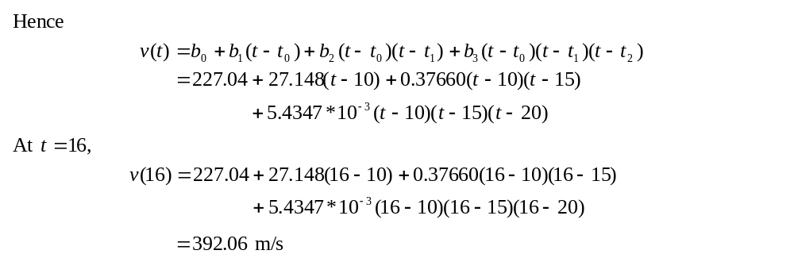

Example
http://numericalmethods.eng.usf.edu

Slide 38
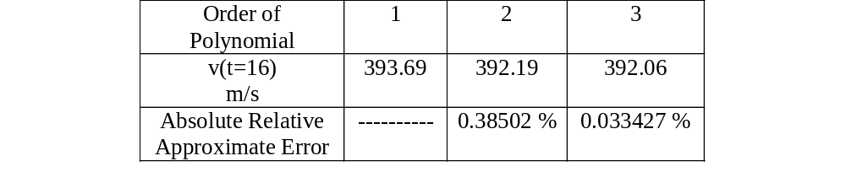
Comparison Table
http://numericalmethods.eng.usf.edu

Slide 39
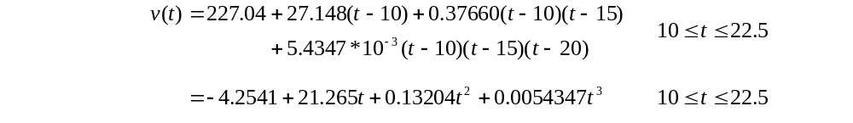
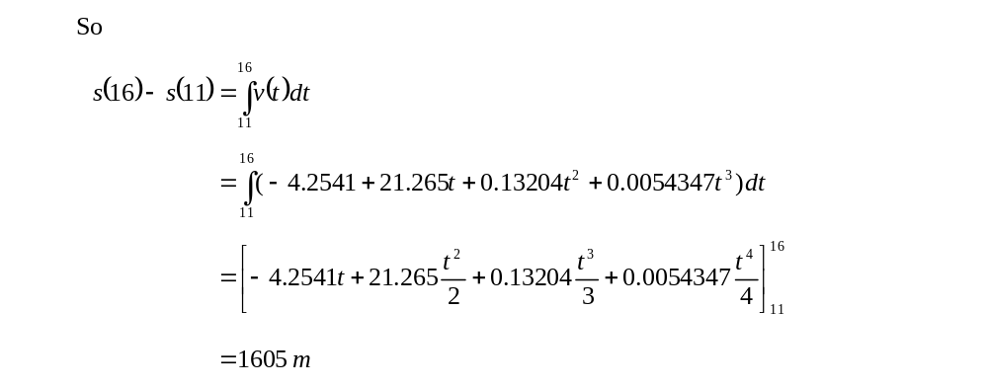
Distance from Velocity Profile
Find the distance covered by the rocket from t=11s to
t=16s ?
http://numericalmethods.eng.usf.edu

Slide 40
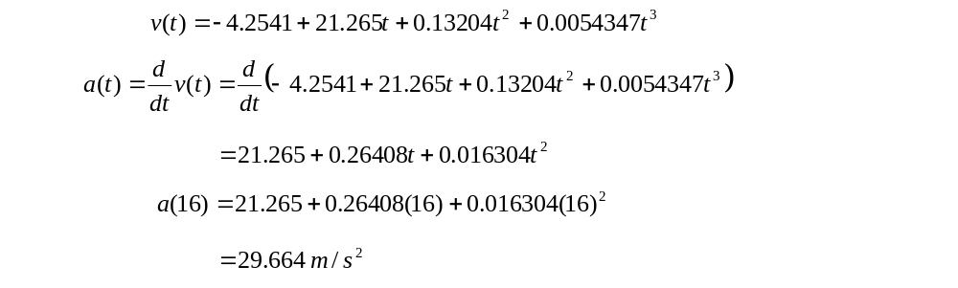
Acceleration from Velocity Profile
Find the acceleration of the rocket at t=16s given that
http://numericalmethods.eng.usf.edu

